Slide 1
GDPR and Altitude Xperience
Helping our customers be GDPR ready

Slide 2

Not About GDPR…
Altitude is committed to support GDPR implementations by providing Altitude Xperience solutions with key functionalities that enable companies address their own GDPR compliance requirements at the contact centre.
Existing versions of Altitude Experience already cover a series of areas that are paramount to increase GDPR compliance in implementations
The Altitude Xperience Roadmap includes a series of new features that further enrich the ability to address GDPR requirements.
But GDPR within Altitude Xperience...

Slide 3
Xperience Addressing GDPR
Use Cases

Slide 4


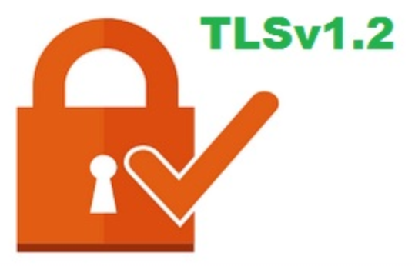


Increased Security
TDE

Slide 5
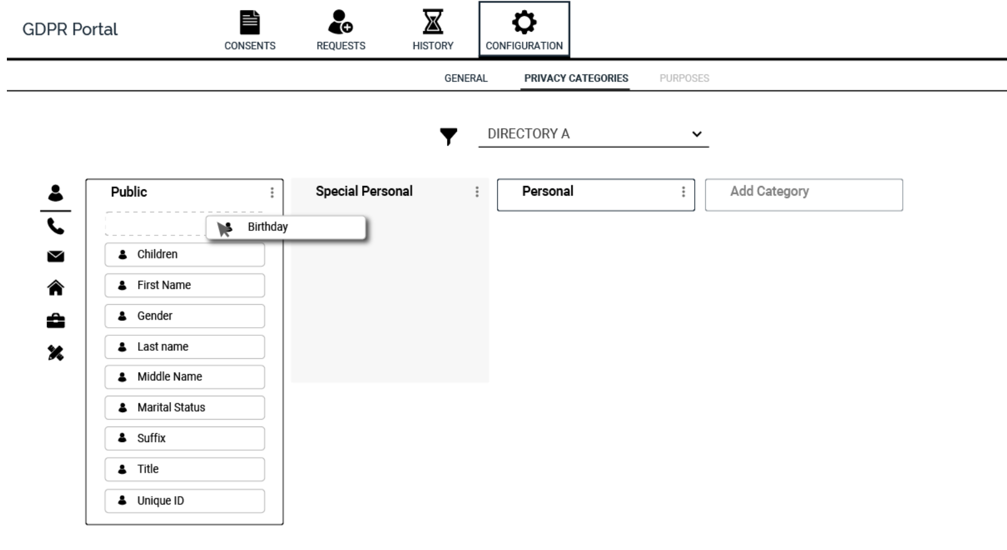
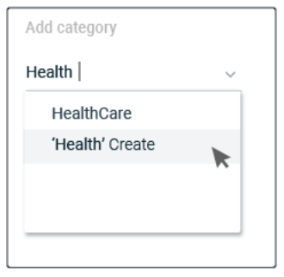
Privacy…
New Portal centralizes GDPR related configurations
Altitude Directory fields can be classified as public or private
Personal data can be classified in multiple sub-categories.

Slide 6
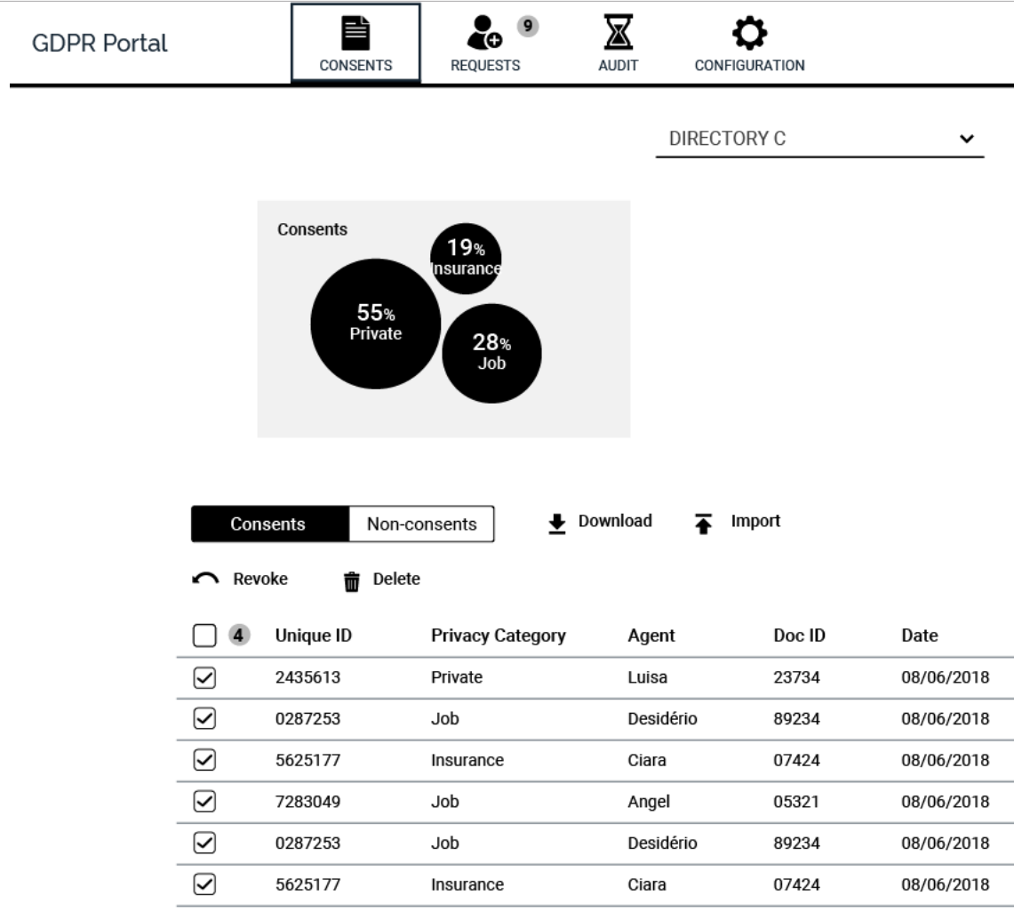
Consent and lawful basis…
Consents can be loaded (in the portal, Xperience Loader), API’s or ASL
Xperience is aware of existing consents for each individual listed in the Altitude Directory
Consents are granted for a specific category of data, are fully logged and can include a document (proof of consent)

Slide 7
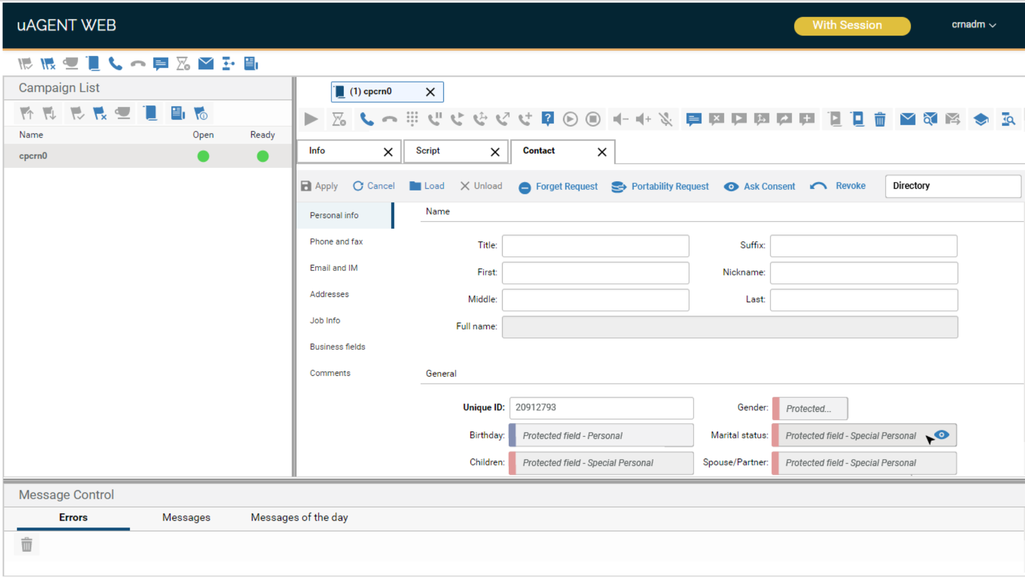
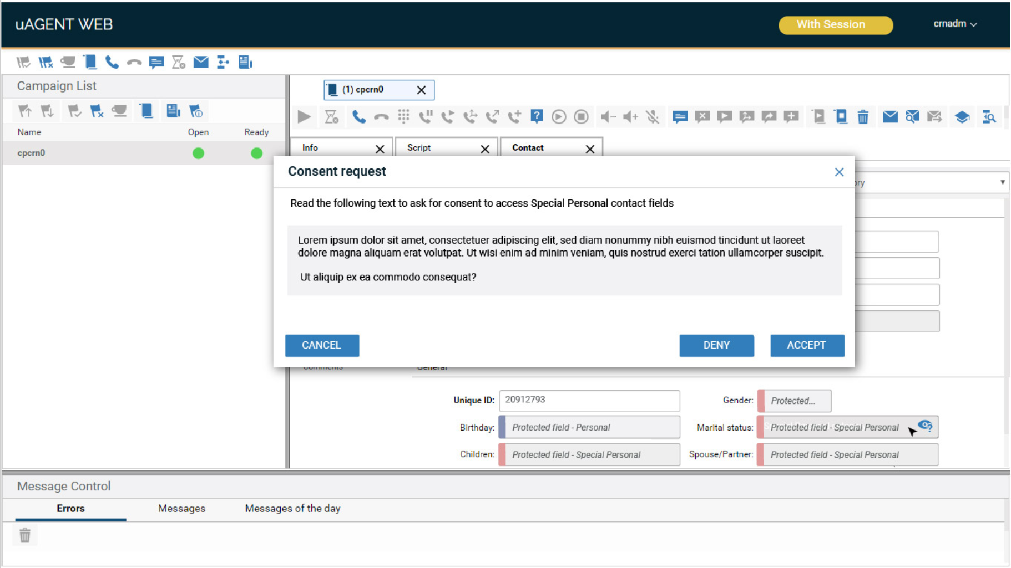
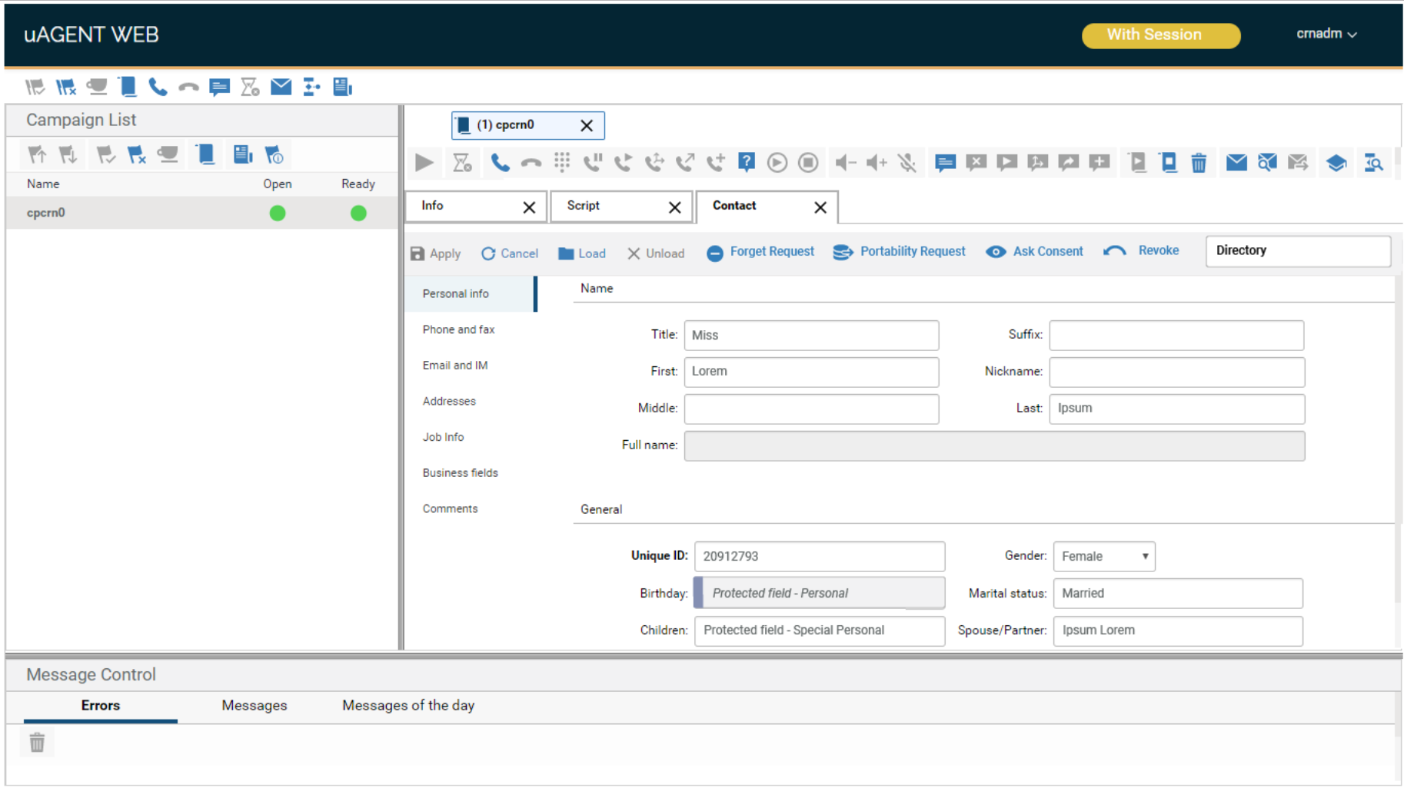
Data masking…
A client that did not provide consent calls customer service. Private information is automatically hidden.
The client accepts and Special Personal fields are uncovered.
The agent asks for consent to access information categorized as Special Personal.

Slide 8
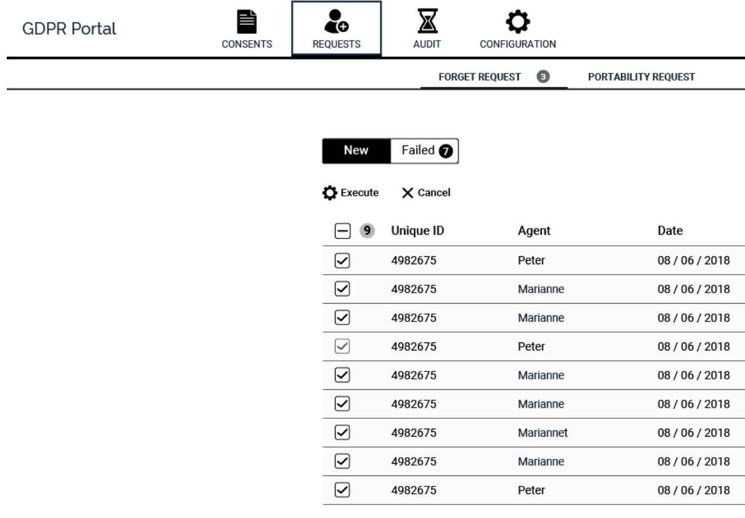
Deletion and portability...
Both operations occur in 2 steps:
Request (Script, API)
Execution (Script, API, Portal)
Deletion and portability target contact profile data.

Slide 9
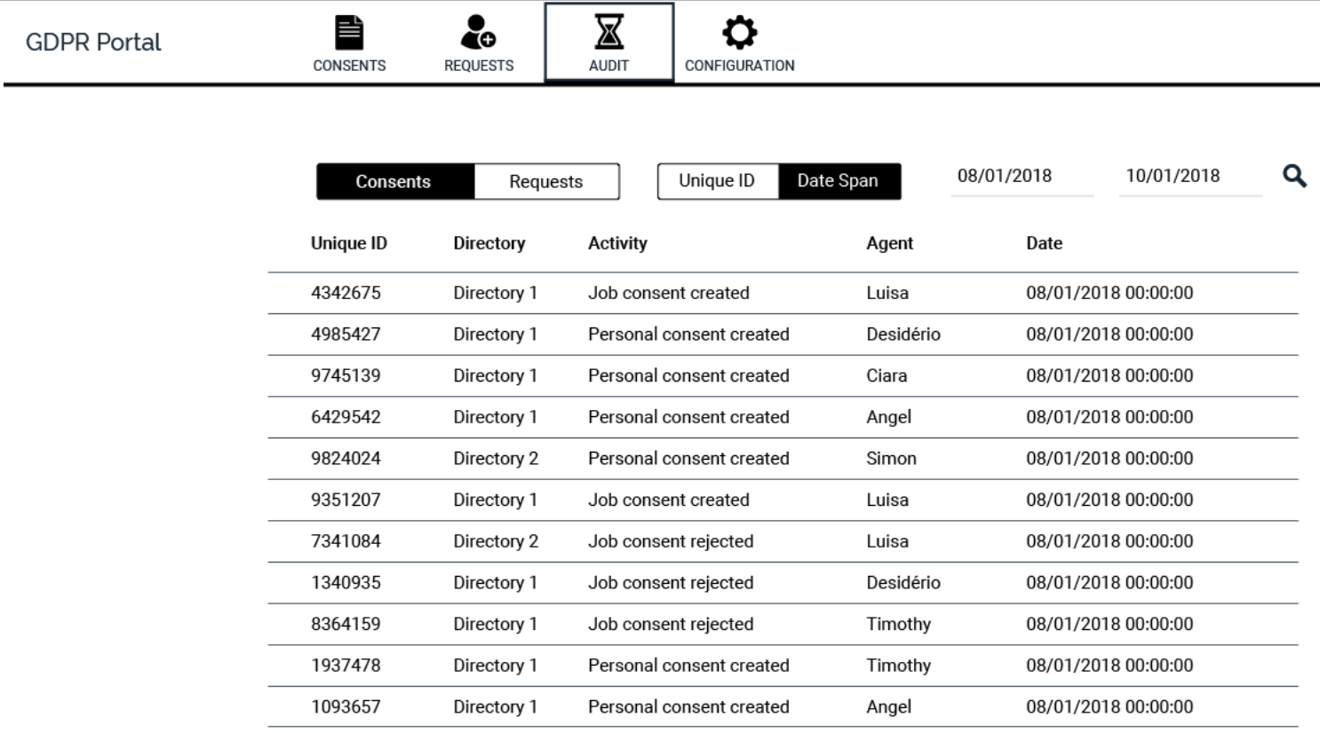
Audit…
Audit information is automatically collected for critical GDPR operations…
Granting and Revoking Consents
Deletion and Portability (requests and execution)

Slide 10
OBRIGADO!

