Slide 1



Product Overview
April 2018

Slide 2




A revolutionary, cost-effective speech analytics and quality management solution
UNLOCK THE VAST AMOUNT OF DATA IN ALL YOUR RECORDINGS
SpeechIQ® makes it easy to analyze recorded calls for compliance, quality assurance, sales effectiveness and more. It’s an easy-to-use, cost-effective solution to drive agent productivity, operations efficiency and improved customer engagement.
  Cloud-based platform
  Proprietary automated speech recognition engine
  Multiple languages
  Quick, easy integration

Slide 3

Product Features
Advanced Search Capabilities
Call Review and Analysis
Customized Daily Notifications
Sentiment Analytics
Customizable Scorecards
Deep-dive Reporting Capabilities

Slide 4


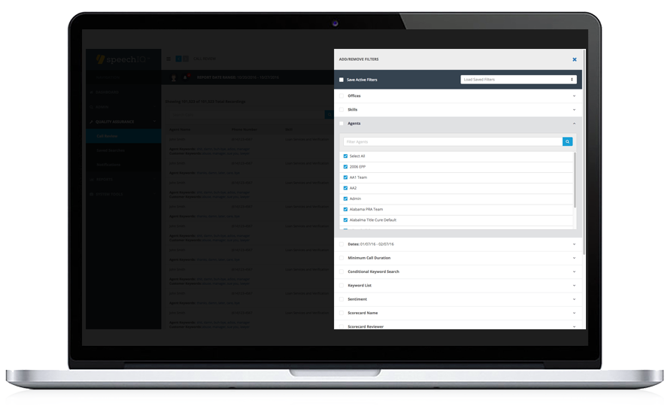
Advanced Search Engine
THE MOST ROBUST SEARCH FILTERING CURRENTLY AVAILABLE
Whether you’re concerned with compliance, sales effectiveness, or customer experience, our cloud-based solution makes it easy to sort through hundreds of thousands of calls to find the data that really matters.
Quickly search by key words and phrases
Build customized key word lists in literally minutes
Boolean search capabilities for more advanced queries
Numerous filters, including office, skill, agent, date range, sentiment, call duration and more
Ability to easily add custom queries based on your actual metadata

Slide 5
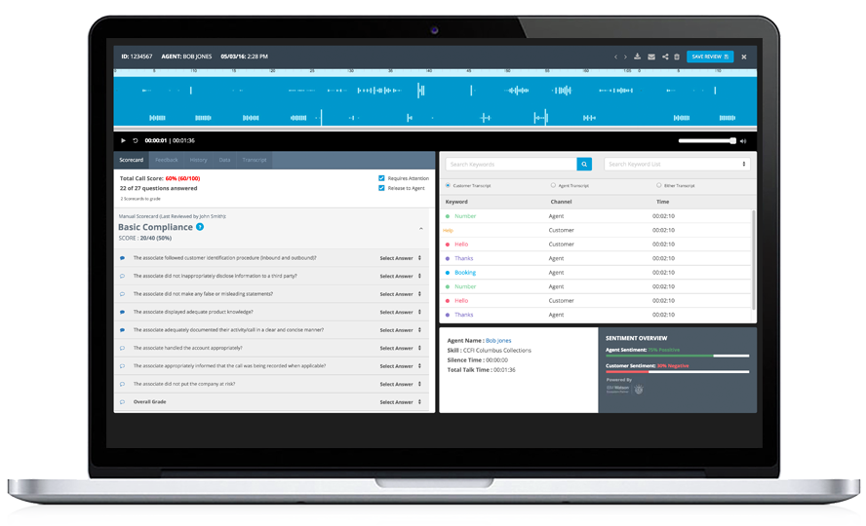
Call Review and Analysis
AN EASY-TO-NAVIGATE CALL REVIEW INTERFACE
Easy to retrieve and review any recorded call
Skip through call to each key word/phrase
Search other words/lists within the call review screen
Add tags within the call for additional search capability
Ability to score calls within the same page view
Each call readily displays key words, agent, skill, talk time, silent time, sentiment, date/time, and more

Slide 6
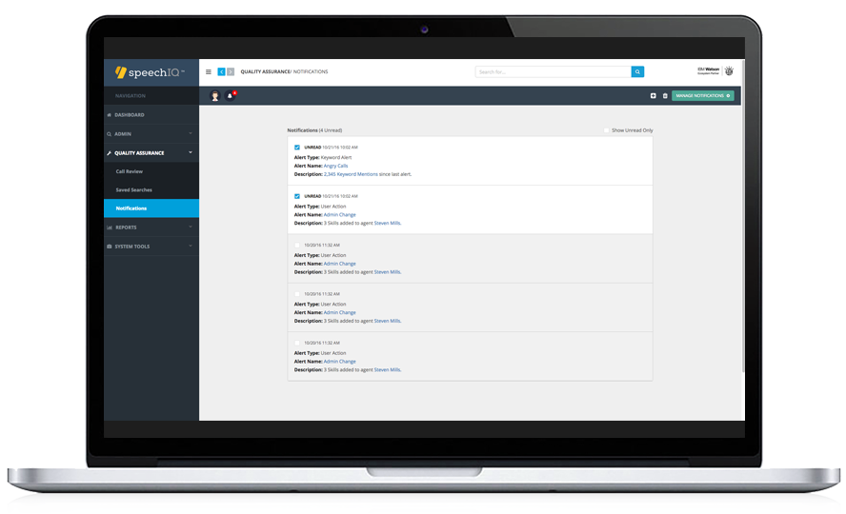
Customized Daily Notifications
STAY UP-TO-THE-MINUTE ON YOUR AGENTS’ PERFORMANCE
Easily set up notifications to be emailed each day regarding specific key words/phrases used in previous day’s calls.
Never miss a chance to improve customer satisfaction. SpeechIQ notifications can be set up to go to directly to your email or you can log in to our cloud-based application and see all the notifications you have set in one easy location.

Slide 7
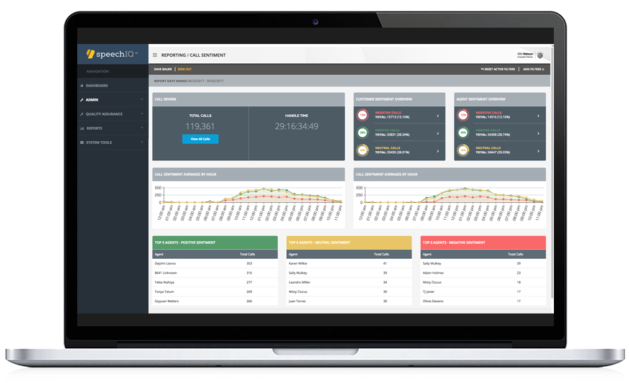
Sentiment Analytics
POWERED BY IBM WATSON
Now you can track the sentiment of any or all of your calls. SpeechIQ leverages IBM Watson to assign a sentiment score to every one of your calls. Perfect to use as a search filter or to identify coaching opportunities and best practices.
Evaluate customer sentiment by agent, salesperson, skill, or office over any period of time
Leverage best practices from top agents
Identify coaching opportunities
Easily compare agent sentiment scores

Slide 8
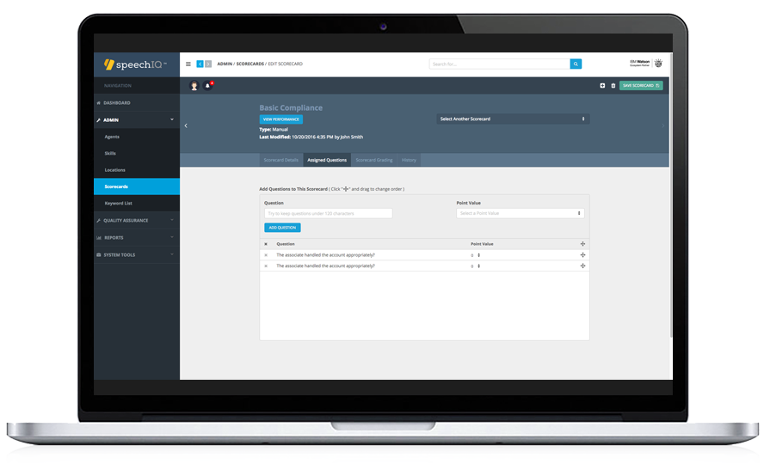
Customizable Scorecards
SIMPLIFIED QUALITY MANAGEMENT
Easily create manual and/or automated scorecards. Our powerful, but easy-to-use automated scorecard capability enables you to score every call based on key words and phrases. It’s a great way to keep an eye on ALL your calls – not just a handful each day.
Create multiple scorecards to address every skill
Automated scorecards available
Ability to add personalized comments to each question
Enable agents to review scored calls and comments while listening to the call
View the history of who has opened/reviewed the call
Ability to search scored calls by scorecard, reviewer, or outcome
Reports display results by scorecard, agent, skill and more

Slide 9
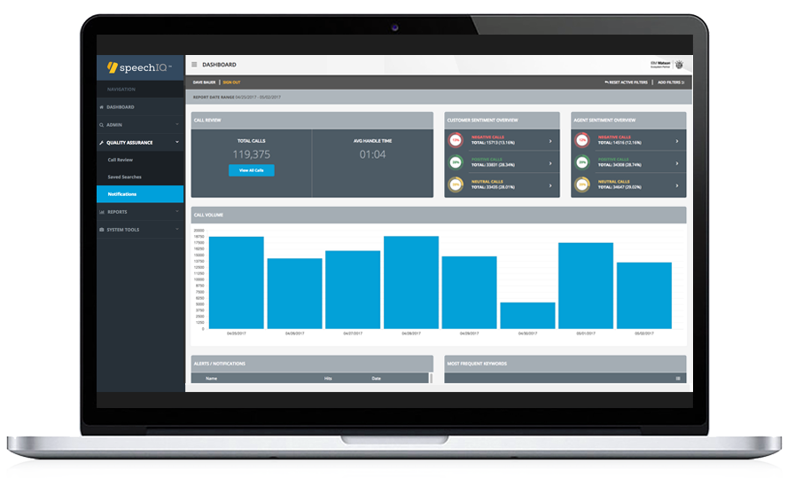
Reporting Capabilities
EASY-TO-GENERATE REPORTS THAT TRACK KEY ACTIVITY
Get a better understanding of the performance of your company. SpeechIQ offers multiple ways to graphically understand your data. Download and export to whatever format best fits your needs.
Virtually every data point is available for reporting
Data can be filtered in multiple ways
Data is exportable to use in other formats
Reports are downloadable for quick and easy presentations

Slide 10

The speechIQ Advantage
SPEECHIQ’S CLOUD-BASED SOLUTION MAKES IT EASY TO QUICKLY STREAMLINE YOUR QA AND CALL REVIEW PROCESS
In a matter of days, we’ll integrate you into our platform so that it’s easy to pass us your recorded calls. An online training session and easy-to-use manual makes it simple for you to start tapping into the wealth of valuable data in your calls.
To start, send us your recorded calls then log into speechIQ. You will see a dashboard of your call data. This is a high-level overview of your call sentiment, keyword usage, agent performance and overall call data.
From the call review screen, you can easily apply filters and key words/phrases to help you better understand your call data. Once these filters are applied, they can be saved for future use.
Simply click on a call from your search results and quickly navigate the call. You ‘ll see the key words you searched, call sentiment, silence time, and more. Plus, you’ll have the ability to score the call and provide valuable coaching tips within each call. We also offer automated scoring — so every call gets scored.

Slide 11
Thank You
Contact us with inquiries:
sales@iqventures.com
278 N. 5th Street Columbus, OH 43215
888.683.1011 | iqventures.com | speechiq.com | businessphone.com

